Slide 1
AN EFFICIENT IRRIGATION PREDICTION FOR INTELLIGENT FARMING SYSTEM

Slide 2
TEAM MEMBERS
PROJECT GUIDE:MR.D.GNANA KUMAR
S.NO | NAME OF THE STUDENT | REGISTER NUMBER
1 | T.AMRUTHA | 9921004728
2 | SD.JAANU AHMEDDUNNISA | 9921004704
3 | SK.TABASUM JAHA | 99210041685
4 | S.V.S.SAI SINDHU | 99210041123

Slide 3
CONTENT
TITLE
INTRODUCTION
LITERATURE SURVEY
CHALLENGES
OBJECTIVE
PROBLEM STATEMENT
SOFTWARE DESCRIPTION
PROPOSED METHODOLOGY
WORK PROGRESS
SYSTEM DESIGN
ALGORITHM
RESULTS
CONCLUSION
REFERENCES
C

Slide 4
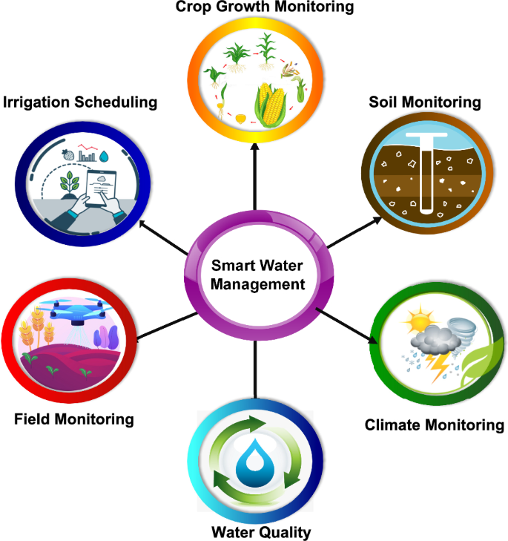
INTRODUCTION
An intelligent farming system, often referred to as precision agriculture or smart farming, integrates technology, data analytics, and automation to enhance the efficiency, productivity, and sustainability of agricultural practices.
This modern approach to farming leverages various technologies to make informed decisions and optimize resource utilization.
Intelligent farming systems can enhance crop yields.

Slide 5
LITERATURE SURVEY
S.NO | Title of the Paper | Year of Published | Objective | Models | Remarks
1 | Improve Irrigation Timing Decision for Agriculture using Real Time Data and Machine Learning | 2020 | This paper presents a study of machine learning algorithms with the objective of predicting the most suitable time of day for water administration to an agricultural field. | Random Forest (RF), Neural Networks (NN), XGBoost, Decision Trees (DT) and Support Vector Machine (SVM) | With the use of a high amount of data previously collected through a Wireless Sensors Network (WSN) spread in an agricultural field.
2 | Improve Energy Efficiency of Irrigation Systems using Smart grid and Random Forest | 2020 | This paper introduces a new methodology to predict power usage in irrigation system, using smartgrid data and Random Forest, in order to improve energy efficiency of these systems. | Deep Neural Networks (DNN) Support vector Machine (SVM) Random Forest | Besides the methodology, this paper includes its implementation and experimental results. It was possible to achieve a 0.0468 Wh error in the prediction and a 87% accuracy in the classification
3 | Precision Irrigation Management Using Machine Learning and Digital Farming Solutions | 2022 |  | Linear Regression Decision Trees . Support Vector Machine (SVM) Random ForestK-Nearest Neighbor (KNN)
4 | Smart irrigation system based on IoT and machine learning | 2022 |  | K-Nearest Neighbors, Neural Network, Naïve Bayes, Support Vector Machine, Logistic Regression

Slide 6
S.NO | Title of the Paper | Year Of Published | Objective | Models | Remarks
3 | A Comparative Study of Machine Learning Algorithms for Irrigation Water Demand Prediction" | 2018 | This study conducts a comparative analysis of various machine learning algorithms for predicting irrigation water demand. Algorithms like Support Vector Machines, Random Forest, and Artificial Neural Networks are evaluated based on their accuracy and efficiency in estimating water requirements. | Random Forest (RF), Neural Networks (NN), and Support Vector Machine (SVM) | This paper is valuable for understanding the strengths and weaknesses of different machine learning approaches in addressing irrigation water demand prediction. The comparison helps researchers and practitioners select the most suitable algorithm for their specific requirements.
4 | Irrigation Scheduling Using Machine Learning Techniques | 2018 | This paper introduces a model for optimizing irrigation schedules using machine learning techniques. It considers factors such as weather conditions, soil properties, and crop characteristics as inputs to predict optimal irrigation timing and amounts. | Decision Tree | The research contributes to more efficient water management in agriculture by automating irrigation scheduling. The incorporation of machine learning enhances precision in scheduling decisions, leading to improved crop yields and water conservation.

Slide 7
S.NO | Title of the Paper | Year Of Published | Objective | Models | Remarks
5 | Machine Learning Approaches for Estimating Crop Evapotranspiration | 2019 | This study explores the use of machine learning algorithms for estimating evapotranspiration in agricultural fields. It utilizes historical weather data, crop type, and soil information to predict evapotranspiration rates. | LSTM | Accurate evapotranspiration estimation is crucial for effective irrigation planning. By harnessing machine learning, this research contributes to better water management by providing reliable estimates of water loss due to evaporation and plant transpiration.
6 | Prediction of Soil Moisture Content Using Machine Learning Algorithms | 2018 | This paper focuses on predicting soil moisture content using machine learning algorithms. It considers meteorological data and soil properties as inputs for various prediction models. | Logistic Regression | Soil moisture prediction is pivotal for determining optimal irrigation timing and amounts. This research aids in optimizing irrigation practices, preventing over- or under-irrigation, and promoting water-use efficiency in agriculture.

Slide 8
S.NO | Title of the Paper | Year Of Published | Objective | Models | Remarks
7 | Irrigation Water Demand Prediction Using Machine Learning Models" | 2018 | This study applies machine learning models to predict irrigation water demand based on factors such as weather data, crop type, and soil characteristics. | Naïve Bayes | Accurate water demand prediction is essential for sustainable water resource management. This research contributes to efficient irrigation planning, which is critical for ensuring food security while conserving water resources..
8 | A Machine Learning Approach for Automated Irrigation Scheduling | 2019 | This paper proposes a machine learning-based automated irrigation scheduling approach that integrates weather forecasts, soil moisture data, and crop growth information. | Decision Tree | Automation in irrigation scheduling streamlines decision-making processes and reduces water wastage. This research has practical implications for enhancing agricultural productivity and resource conservation through timely and informed irrigation practices.These research papers collectively highlight the importance of using machine learning algorithms in irrigation prediction.

Slide 9
S.NO | Title of the Paper | Year Of Published | Objective | Models | Remarks
9 | Research and implementation of agricultural water-saving irrigation prediction algorithm based on GA-BP neuralnetwork | 2022 | This paper proposes an agricultural water-saving irrigation prediction algorithm using Genetic Algorithm (GA) to optimize BP neural network. Factors such as humidity and light intensity are used as inputs to the neural network. | BP Neural network | The conclusion proves that the application of GA-BP neural network agricultural water-saving irrigation prediction algorithm has high accuracy in predicting crop water demand, can better achieve the purpose of water-saving irrigation, and has strong adaptability.
10 | Precision Irrigation Management Using Machine Learning and Digital Farming Solutions | 2022 | This article reviews the research trend and applicability of machine learning techniques, as well as the deployment of developed machine learning models for use by farmers toward sustainable irrigation management. | Linear Regression Decision Trees . Support Vector Machine (SVM) Random ForestK-Nearest Neighbor (KNN) | It further discusses how digital farming solutions, such as mobile and web frameworks, can enable the management of smart irrigation processes, with the aim of reducing the stress faced by farmers and researchers due to the opportunity for remote monitoring and control.

Slide 10
CHALLENGES
Generally , Irrigation prediction has been explored in research. But Some challenges might encounter including input parameters ,model selections, feature selection etc…
Give the output as at what time we have to irrigate the land.
Uses the smartgrid dataset.
Model selection
Model complexity
Note:
Based on above challenges, we decided to develop a model which takes the input parameters such as geographical location, crop type, date of seed sowing, temperature, Humidity and it predicts a land has to irrigate or not..

Slide 11
OBJECTIVE
To Develop and Implement solution for an efficient irrigation
prediction in an Intelligent Farming System

Slide 12
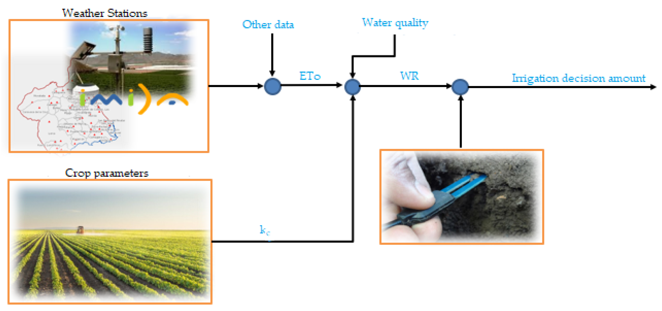
PROBLEM STATEMENT
The problem at hand is to develop a comprehensive Intelligent Farming System capable of receiving inputs such as geographical location, soil moisture levels, crop type, and temperature, and then providing accurate recommendations on whether a specific land area requires irrigation or not.

Slide 13

SOFTWARE DESCRIPTION
scikit-learn, also known as sklearn, is a popular open-source machine learning library for the Python programming language.
It aims to provide accessible and consistent interfaces for a variety of machine learning tasks.
Reason to choose the software:
scikit-learn's consistent API and user-friendly documentation make it relatively easy to understand and implement machine learning models. It follows a simple "fit-transform-predict" paradigm, allowing users to easily train models, transform data, and make predictions.

Slide 14
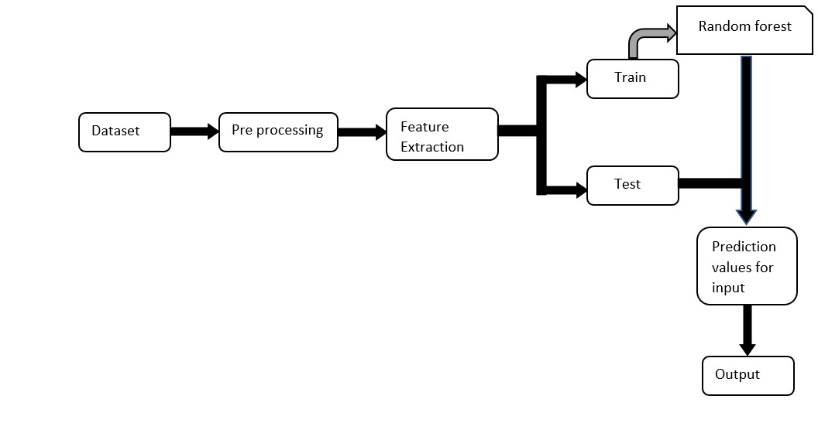
PROPOSED METHODOLOGY (RANDOM FOREST)

Slide 15

DATASET

Slide 16
WORK PROGRESS
Project Planning
Data Collection and Preprocessing
Feature Engineering
Model Development
Model Serialization
Real-time Prediction and Output Handling
User Interface
Testing and Quality Assurance
Deployment
Evaluation and Optimization

Slide 17
SYSTEM DESIGN
Data Collection
Data Preprocessing
Model Training
Model Serialization
Real-time Prediction
Output Handling
Integration with Farming system
User Interface
Security and Data Privacy

Slide 18
SYSTEM DESIGN
SYSTEM REQUIREMENTS :
Software Requirements
Data Sources
Power Supply
Internet Connectivity
Security

Slide 19

ALGORITHM
RANDOM FOREST :
Random Forest is a machine learning algorithm that is used for both classification and regression tasks. It is a type of ensemble learning method that combines multiple decision trees to make more accurate predictions.
Random Forest works by creating a large number of decision trees, where each tree is trained on a randomly selected subset of the training data and a randomly selected subset of the features. During the training process, each tree in the forest is grown to its maximum depth without pruning.
Overall, Random Forest is a powerful machine learning algorithm that can be used for a variety of tasks. Its ability to handle both numerical and categorical data and reduce the risk of overfitting makes it a popular choice in many domains.

Slide 20
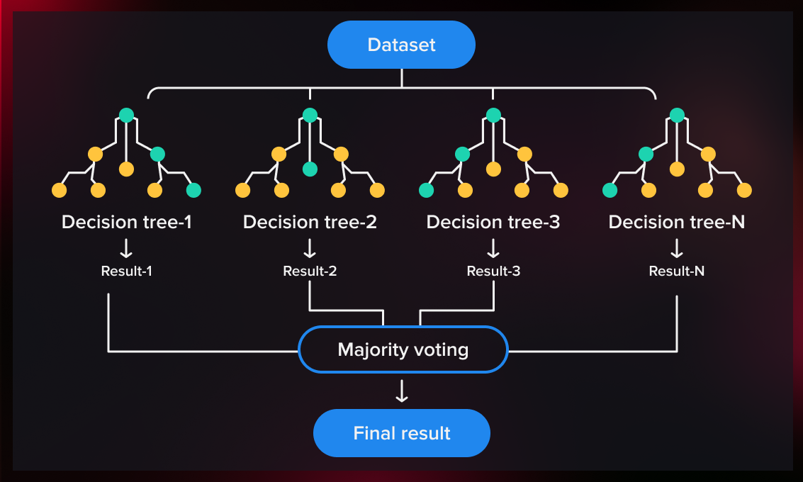
RANDOM FOREST

Slide 21
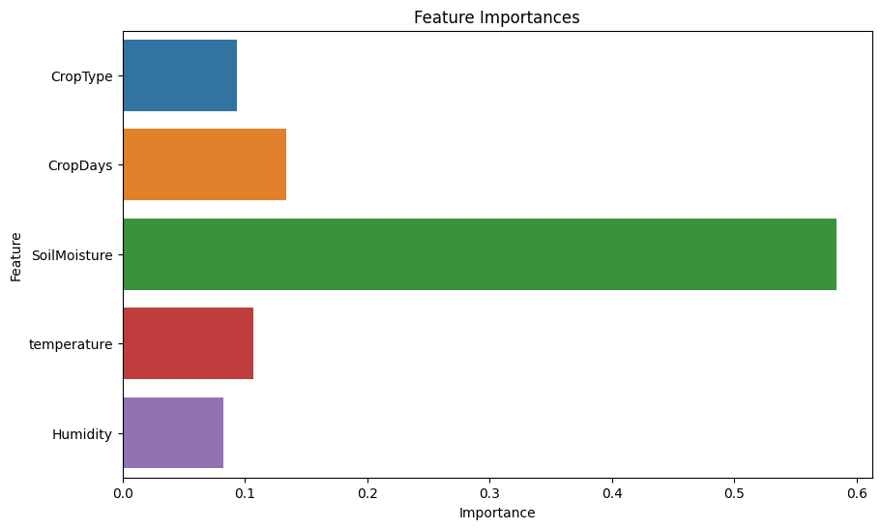
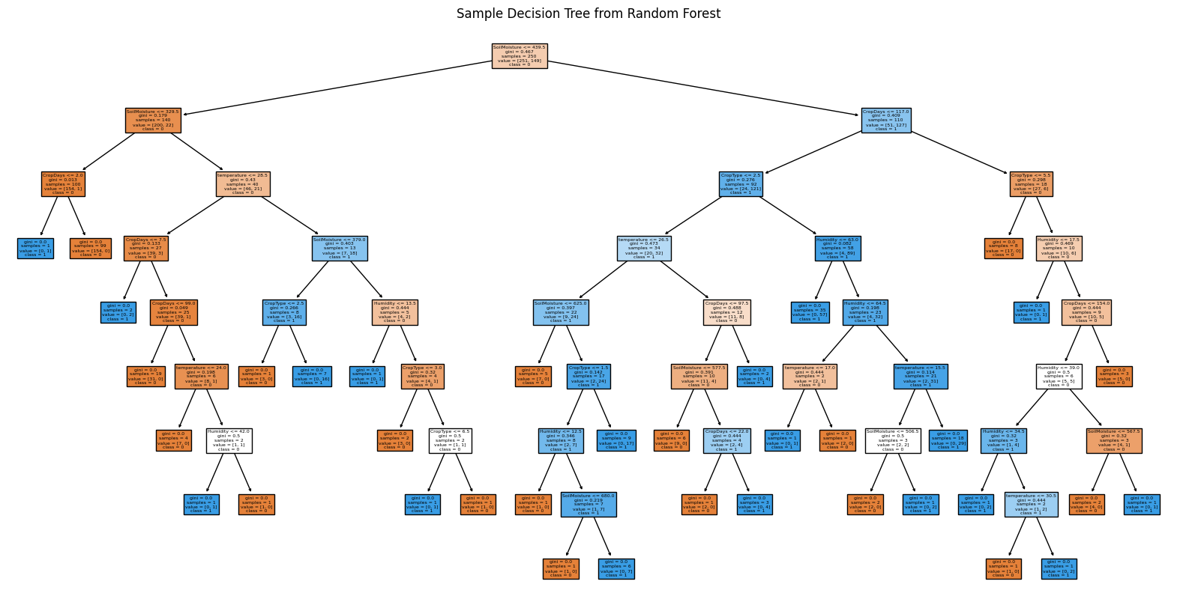
RESULTS

Slide 22
RESULTS
PARAMETER | RANDOM FOREST | DECISION TREE | SVM | LOGISTIC REGRESSION
Accuracy | 95.05% | 92.08% | 91.09% | 88.12%
Precision | 0.97 | 0.93 | 0.88 | 0.89
Recall | 0.90 | 0.88 | 0.90 | 0.81

Slide 23
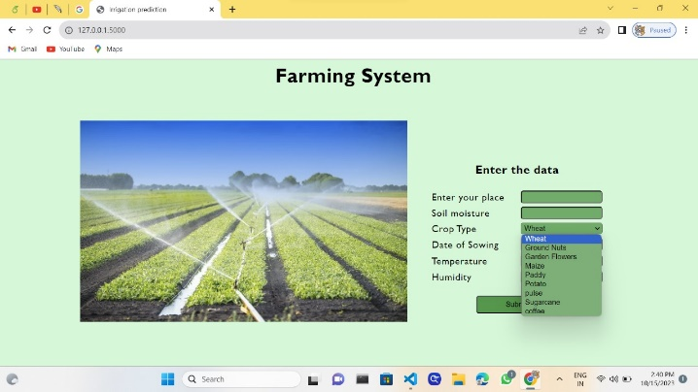
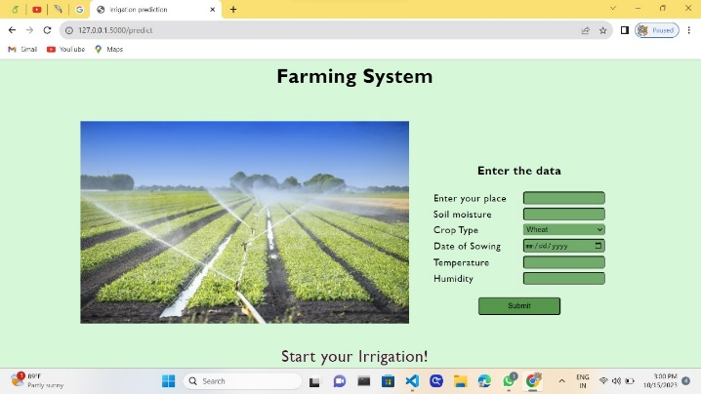
OUTPUT

Slide 24

OUTPUT

Slide 25
BENEFITS
Optimized Water Usage
Improved Crop Yields
Reduced Resource Waste
Lower Operating Costs
Increased Profitability
Time Savings

Slide 26
CONCLUSION
The ability to estimate irrigation needs is an essential part of agricultural management since it enables farmers to maximize water use and increase crop yields. In order predict irrigation requirements, a variety of techniques are utilized, such as soil moisture monitors, weather-based models, and remote sensing technologies .The type of crop, the qualities of the soil, the climate, and the available resources all affect which prediction approach is the most accurate. To ensure reliable and exact predictions, it is important to choose the method that is most appropriate given the above factors. Predicting irrigation demands is essential for sustainable agriculture since it may save water usage, boost crop output, and encourage environmental preservation.

Slide 27
FUTURE SCOPE
Since it's still a prototype, it can't make an accurate determination based only on pictures as to whether a piece of land needs irrigation or not.
The current model simply uses a machine learning algorithm to predict the output.
We hope to enhance this project going forward by utilizing neural network algorithms to predict the image output.

Slide 28
REFERENCES
"Application of Machine Learning Algorithms in Precision Agriculture: A Review" by Singh A. et al.
"Decision Support Systems in Agriculture" by Juan M. García-Chicote and Juan A. Lara.
Agricultural Extension and Research: Achievements and Challenges by Pratap S. Birthal et al.
Precision Agriculture Journal
"Smart Agriculture for Sustainable Farming" by Monika Garg and Poonam Singh Nigam.

Slide 29
Thank you

